Slide 1
FileReader,FileWriter, BufferedReader,BufferedWriter DataInputStream, DataOutputStream

Slide 2
DataOutputStream and DataInputStream
DataOutputStream and DataInputStream enable you to write or read primitive data to or from a stream.
They implement the DataOutput and DataInput interfaces, respectively.
These interfaces define methods that convert primitive values to or from a sequence of bytes.
These streams make it easy to store binary data, such as integers or floating-point values, in a file.

Slide 3
DataOutputStream
DataOutputStream(OutputStream outputStream)
final void writeDouble(double value) throws IOException
final void writeBoolean(boolean value) throws IOException
final void writeInt(int value) throws IOException

Slide 4
DataInputStream
DataInputStream(InputStream inputStream)
double readDouble( ) throws IOException
boolean readBoolean( ) throws IOException
int readInt( ) throws IOException

Slide 5
Example
class DataIODemo {
public static void main(String args[]) throws IOException {
FileOutputStream fout = new FileOutputStream("Test.dat");
DataOutputStream out = new DataOutputStream(fout);
out.writeDouble(98.6);
out.writeInt(1000);
out.writeBoolean(true);
out.close();
FileInputStream fin = new FileInputStream("Test.dat");
DataInputStream in = new DataInputStream(fin);
double d = in.readDouble();
int i = in.readInt();
boolean b = in.readBoolean();
System.out.println("Here are the values: " +
d + " " + i + " " + b);
in.close();
}
}

Slide 6
Reader and Writer
Reader is an abstract class that defines Java’s model of streaming character input. It implements the Closeable and Readable interfaces.
Writer is an abstract class that defines streaming character output. It implements the Closeable, Flushable, and Appendable interfaces

Slide 7
FileReader and FileWriter
The FileReader class creates a Reader that you can use to read the contents of a file. Its two most commonly used constructors are shown here:
FileReader(String filePath)
FileReader(File fileObj)
FileWriter creates a Writer that you can use to write to a file. Its most commonly used constructors are shown here:
FileWriter(String filePath)
FileWriter(String filePath, boolean append)
FileWriter(File fileObj)
FileWriter(File fileObj, boolean append)

Slide 8
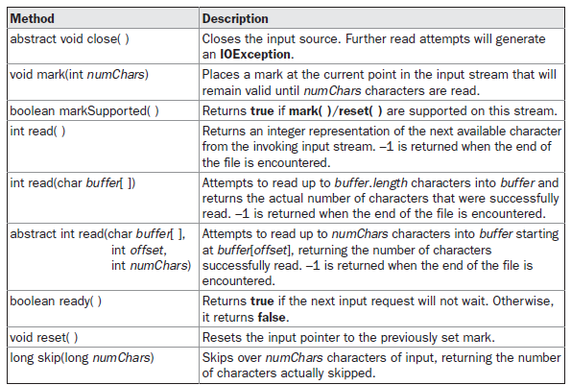
Reader methods

Slide 9
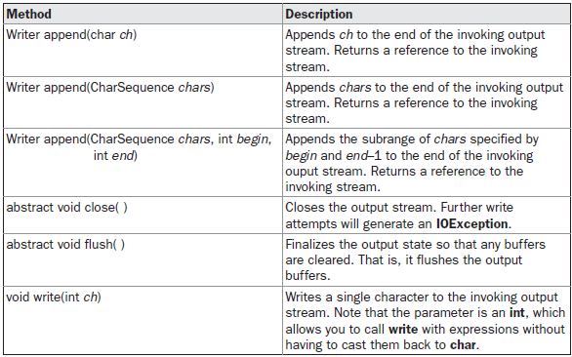
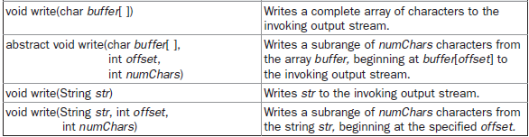
Writer Methods

Slide 10
File Reader Example
import java.io.*;
class FileReaderDemo {
public static void main(String args[]) throws IOException {
FileReader fr = new FileReader("FileReaderDemo.java");
BufferedReader br = new BufferedReader(fr);
String s;
while((s = br.readLine()) != null) {
System.out.println(s);
}
fr.close();
}
}

Slide 11
File Writer Example
class FileWriterDemo {
public static void main(String args[]) throws IOException {
String source = "Now is the time for all good men\n"
+ " to come to the aid of their country\n"
+ " and pay their due taxes.";
char buffer[] = new char[source.length()];
source.getChars(0, source.length(), buffer, 0);
FileWriter f0 = new FileWriter("file1.txt");
for (int i=0; i < buffer.length; i += 2) {
f0.write(buffer[i]);
}
f0.close();
FileWriter f1 = new FileWriter("file2.txt");
f1.write(buffer);
f1.close();
FileWriter f2 = new FileWriter("file3.txt");
f2.write(buffer,buffer.length-buffer.length/4,buffer.length/4);
f2.close();
}
}

Slide 12
BufferedWriter Class
Java BufferedWriter class is used to provide buffering for Writer instances. It makes the performance fast. It inherits Writer class. The buffering characters are used for providing the efficient writing of single arrays, characters, and strings.
BufferedWriter(Writer wrt) | It is used to create a buffered character output stream that uses the default size for an output buffer.
BufferedWriter(Writer wrt, int size) | It is used to create a buffered character output stream that uses the specified size for an output buffer.

Slide 13
BufferedWriter Class
Method | Description
void newLine() | It is used to add a new line by writing a line separator.
void write(int c) | It is used to write a single character.
void write(char[] cbuf, int off, int len) | It is used to write a portion of an array of characters.
void write(String s, int off, int len) | It is used to write a portion of a string.
void flush() | It is used to flushes the input stream.
void close() | It is used to closes the input stream

Slide 14
BufferedWriter
import java.io.*;
public class BufferedWriterExample {
public static void main(String[] args) throws Exception {
FileWriter writer = new FileWriter("D:\\testout.txt");
BufferedWriter buffer = new BufferedWriter(writer);
buffer.write("Welcome.");
buffer.close();
System.out.println("Success");
}
}

Slide 15
BufferedReader
Java BufferedReader class is used to read the text from a character-based input stream. It can be used to read data line by line by readLine() method. It makes the performance fast. It inherits Reader class.
Constructor | Description
BufferedReader(Reader rd) | It is used to create a buffered character input stream that uses the default size for an input buffer.
BufferedReader(Reader rd, int size) | It is used to create a buffered character input stream that uses the specified size for an input buffer.

Slide 16
BufferedReader
Method | Description
int read() | It is used for reading a single character.
int read(char[] cbuf, int off, int len) | It is used for reading characters into a portion of an array.
boolean markSupported() | It is used to test the input stream support for the mark and reset method.
String readLine() | It is used for reading a line of text.
boolean ready() | It is used to test whether the input stream is ready to be read.
long skip(long n) | It is used for skipping the characters.
void reset() | It repositions the stream at a position the mark method was last called on this input stream.
void mark(int readAheadLimit) | It is used for marking the present position in a stream.
void close() | It closes the input stream and releases any of the system resources associated with the stream.

Slide 17
BufferedReader
public class BufferedReaderExample {
public static void main(String args[])throws Exception{
FileReader fr=new FileReader("D:\\testout.txt");
BufferedReader br=new BufferedReader(fr);
int i;
while((i=br.read())!=-1){
System.out.print((char)i);
}
br.close();
fr.close();
}
}

